Slide 1




Managing Devices and networking
Unit 6

Slide 2
THE IMPORTANCE OF DEVICE DRIVERS
Device drivers act as an interface between the operating system and hardware devices. Drivers are crucial for devices to function properly, or to even function at all within the Linux environment.
Notes:
No matter what the device is that you're trying to use, you need to make sure it has proper driver support under Linux, and that your Linux system actually has those drivers. Otherwise, you may be unable to use that device, or use it well

Slide 3
THIN CLIENTS
A client device, typically referred to as a thin client, is any lightweight computing device that connects to a more powerful server for doing work. The server does most of the heavy lifting, including processing and storing data, while the thin client acts as little more than a user interface.
Notes:
A thin client will typically have fundamental I/O devices like a keyboard, mouse, and monitor connected to it. It may or may not be running Linux, and if it is, it will typically be a lightweight distribution with very few features available or permissible to the user. The server the client connects to will usually construct a virtual environment so that the user can work in a sandbox, segmented from other portions of the server or network. The server, like the client, may be running Linux or another operating system.

Slide 4
USB DEVICES
A wide range of USB device types are supported in Linux, including, but not limited to:
• Thumb drives
• External HDDs and SSDs
• Digital cameras
• Smartphones and tablets
• Printers and scanners
• Keyboards and mice
• Microphones and webcams
• Game controllers
Notes:
USB also incorporates plug-and-play technologies that enable devices to self-configure as soon as a connection is made.

Slide 5
WIRELESS DEVICES
Wi-Fi: A technology used primarily in establishing a wireless local area connection (WLAN) in home and office environments.
Bluetooth: A technology used primarily for establishing a personal area network (PAN) in which devices communicate wirelessly within a few feet of each other.
Near Field Communication (NFC): A communications protocol used by mobile devices and peripherals that are either touching or only inches apart.

Slide 6
A network adapter, also known as a network interface card (NIC), is a device that provides an interface with which hosts exchange data over a network.
Serial AT Attachment (SATA) is a computer bus interface standard for attaching storage devices to traditional computers. In modern PCs, SATA has largely replaced earlier standards like Parallel ATA (PATA) and Integrated Drive Electronics (IDE) as one of the dominant standards in storage connection technology.
Small Computer System Interface (SCSI) is a computer bus interface for connecting peripheral devices to traditional computers.

Slide 7
A host bus adapter (HBA) is a hardware component that connects a host system to a storage device, like in a storage area network (SAN), in order to facilitate the input and output of data.
Peripheral Component Interconnect (PCI) is a connection interface standard that is primarily used as an expansion bus for attaching peripheral devices.

Slide 8
Which of the following wireless connection standards is primarily used to create a local area network (LAN) for home and office computing?
NFC
Bluetooth
Wi-Fi
RFID

Slide 9
Which of the following hardware interfaces carries audio and video signals and is used to connect devices like monitors?
USB
HDMI
Wi-Fi
VGA

Slide 10
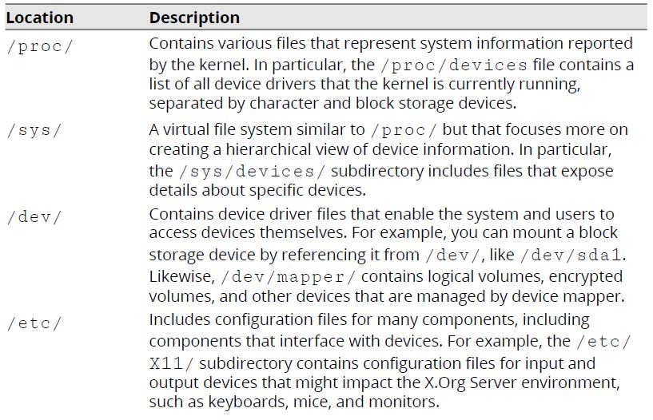
Configure Devices
DEVICE FILE LOCATIONS
Device files represent information about hardware devices, and in some cases, define settings about those devices that you can customize.

Slide 11
A hotpluggable device can be physically added or removed from the system without requiring a reboot in order to use that device.
Modern Linux distributions support hotplugging for many standard bus types, particular for USB, FireWire, SATA, and other related technologies.
Notes:
Hotpluggable devices are detected by the system as they are plugged in, whereas cold pluggable devices, such as RAM modules, CPUs, and some internal storage devices, are not sensed when connected to a running system; they need a complete reboot of the system to function.
In fact, for internal devices like RAM modules, it is highly recommended that the system is powered off before attempting to plug the device in.

Slide 12
udev
The device manager udev manages the automatic detection and configuration of hardware devices. udev is an integral part of the kernel that is initialized during boot time. The udev utility handles module loading for both coldpluggable and hotpluggable devices.
udev RULES
The /etc/udev/rules.d/ directory is used to configure rules for how udev functions.
Notes:
It loads the modules for coldpluggable devices when the system is booted. The modules for hotpluggable devices are loaded by udev dynamically during system run time.
Udev rules
You can create files in this directory that tell udev to configure a device in a certain way or run a certain command when a device is plugged in.

Slide 13
THE udevadm COMMAND
The udevadm command is used to manage udev. It takes various subcommands, each of which performs a certain task to modify the behavior of the systemd-udevd daemon and related components.
Info → retrieve device information stored in the udev database or example, you can view a device's vendor ID, product ID, serial number, and much more.
Control → Modify the running state of udev. For example, providing the -- reload-rules option will ensure that udev is reading from any new rules files you've added.
monitor → Watch for events sent by the kernel or by a udev rule.
test → Simulate a udev event running for a device, with results on output.
SYNTAX
The syntax of the udevadm command is udevadm [options] [subcommand] [arguments]

Slide 14
PRINTING SOFTWARE
Printers are typically bundled with software utilities that enable you to configure settings for the printer. These utilities may target a specific operating system, so you need to confirm whether or not they were designed to run on Linux.

Slide 15
CUPS
CUPS (Common Unix Printing System)is a print management system for Linux that enables a computer to function as a print server. A system running CUPS is a host that can initiate print jobs from client systems.
CUPS is designed for scheduling print jobs, processing administrative commands, and providing printer status information to local and remote programs. CUPS provides a web-based interface for configuring the service.
Changes made through this interface modify the /etc/cups/cupsd.conf and /etc/cups/cups-files.conf files.

Slide 16
THE lpr COMMAND
The lpr command submits files for printing. Files supplied at the command-line are sent to the specified printer or to the print queue if the printer is busy.
Without specifying the printer to use, the command will send the print job to the default printer, which you can configure with CUPS.
The lpr command reads the print file from standard input if no files are supplied at the command-line.
SYNTAX
The syntax of the lpr command is lpr [options] [file names]

Slide 17
Monitor Devices
THE lsdev COMMAND
The lsdev command displays various information about a system's hardware as reported by the kernel. It compiles this information from three files in the /proc/directory:
/proc/interrupts —This file lists each logical CPU core and its associated interrupt requests (IRQ). An IRQ is a signal sent by a device to the processor so that the processor can stop what it is doing and handle some task that the hardware needs to perform, like pressing a keystroke or moving the mouse.
/proc/ioports —This file lists I/O ports and the hardware devices that are mapped to them.

Slide 18
THE lsusb COMMAND
The lsusb command is used to display information about devices that are connected to the system's USB buses. This command scans the /dev/bus/usb/ directory for information.
By default, the command will print the number of the bus and the connected device, the ID of the device, and the name of the vendor and product matching that device.
You can use the -v flag to see detailed information about each device, similar to using the udevadm info command. You can also filter results by bus (-s) and by vendor/product (-d).
SYNTAX
The syntax of the lsusb command is lsusb [options]

Slide 19
THE lpq COMMAND
The lpq command shows the status of the printer queue. By default, it will report each print job's rank in the queue, who owns the job, the job number, the files in the job, and the size of the job.
SYNTAX
The syntax of the lpq command is lpq [options]

Slide 20
Troubleshoot Hardware Issues
COMMON HARDWARE ISSUES
Problems can affect a wide array of different hardware devices. Missing or poorly configured drivers are a common source of these problems, as is user space software that is incompatible with certain hardware.
In general, hardware issues can be categorized as follows:
• Keyboard mapping issues.
• Communications port issues.
• Printer issues.
• Memory issues.
• Video issues.
• Storage adapter issues.

Slide 21
KEYBOARD MAPPING ISSUES
Certain keyboard keys, when pressed, may produce an unexpected character on the screen, or no character at all. This is the most common and overt symptom of a keyboard mapping issue.
To address the problem, make sure you can correctly identify the layout of the physical keyboard—not just its overall design type (e.g., QWERTY vs. Dvorak), but its specific regional layout.

Slide 22
PRINTER ISSUES
Printers are a very common source of issues. In many cases, the printer itself will be at fault:
• It may be out of ink or paper.
• There may be a paper jam.
• The mechanical components may be damaged or misaligned.
• And many more issues.

Slide 23
MEMORY ISSUES
From a software perspective, memory can "leak" when a process fails to free up allocated memory when it is no longer needed.
In these cases, you can use memory monitoring tools like free as well as process monitoring tools like top to identify the problem, then deal with the offending process (e.g., by killing it).
Notes:
The total available memory on the system is quickly exhausted. This can lead to general performance degradation and system instability because other software is unable to access the memory it needs

Slide 24
VIDEO ISSUES
Common video-related issues include:
• Consistent or intermittent blank screens.
• Incorrectly displayed colors.
• Multiple monitors not being detected.
• Sluggish performance in video-intensive applications.
• And more.
Notes:
Some of these issues can be addressed by ensuring that monitors and other display devices are properly connected and are compatible with the system and user software.

Slide 25
STORAGE ADAPTER ISSUES
There are several possible indicators of a faulty bus adapter, including:
• Poor data transfer speeds.
• Less total space available than expected.
• Excessive read/write errors.
• Inability to read/write at all.
• The system cannot detect devices at all.
• And more.

Slide 26
THE lshw COMMAND
The lshw command lists each detected hardware component on the system and provides details about each device. The command pulls information from many different files in multiple device file locations like /proc/ and outputs in a hierarchical format.
SYNTAX
The syntax of the lshw command is lshw [options]

Slide 27
ABRT
The Automatic Bug Reporting Tool (ABRT) is a utility, typically used on Fedora- and RHEL-based distros, that analyzes and reports on problems detected during system runtime. ABRT collects data like memory dumps from crashed applications to help administrators diagnose and troubleshoot issues. It can also report on problems with various devices, such as MCEs that typically indicate hardware failure.

